Slide 1
CT425
RF and Antenna Engineering
By
Prof. Deepak Ghodgaonkar deepak_ghodgaonkar@daiict.ac.in
Room # 1103, Faculty Block 1
Extension x 623
Mobile - 9924143743
25th July 2023

Slide 2
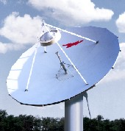
Andrew 6.5 – meter Diameter
E.S. antenna
C-band Operation
  Rx: 3.400 - 4.200 GHz
  Tx: 5.850 - 6.725 GHz
Gain:
  Rx: 46.5 dBi (midband)
  Tx: 51.0 dBi (midband)
Beamwidth Rx (Tx) degrees:
  .68 (.42)
  1.32 (.84)
VSWR < 1.3:1
Polarization Isolation: >35 dB
Weight: 6400 lbs

Slide 3
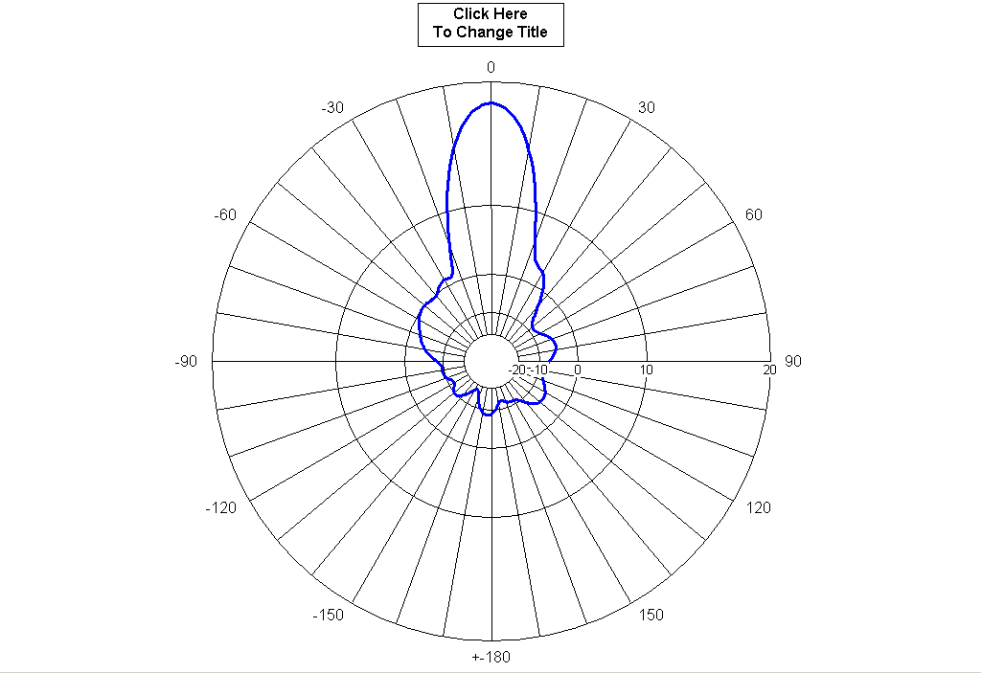
Radiation Pattern

Slide 4
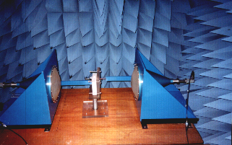
Free-Space Microwave Measurement System

